Slide 1

Blinkit Sales Analysis Project
Developed to Improve My Skills in Data Analysis Using Excel
- Mithun Adhe
Data Analyst

Slide 2
Problem Statement
To analyze Blinkit’s sales data to understand performance, customer satisfaction, and inventory trends. This project was developed to strengthen my Excel and data analysis skills.
- Mithun Adhe (Data Analyst)

Slide 3
KPIs Tracked
List the 4 Key Metrics:
Total Sales: Overall revenue generated.
Average Sales: Revenue per sale.
Number of Items: Count of all items sold.
Average Rating: Customer satisfaction rating.
- Mithun Adhe (Data Analyst)

Slide 4
Methodology
Data Cleaning: Removed duplicates, handled missing values.
Pivot Tables: Summarized data.
Charts: Visualized trends using Donut, Bar, Line, Stacked Column, and Funnel charts.
- Mithun Adhe (Data Analyst)

Slide 5
Fat Content Analysis
Visuals:
Fat Content Pie Chart
Fat Content by Outlet (Bar Graph)
Insights:
Regular fat items dominate sales (65%).
Tier 3 outlets contribute the most to fat-related sales.
- Mithun Adhe (Data Analyst)

Slide 6
Sales by Item Type
Visuals:
Bar Graph for Item Types (Fruits & Vegetables, Snack Foods, etc.)
Insights:
Fruits & Vegetables and Snack Foods are top contributors.
Household and Frozen Foods show consistent demand.
- Mithun Adhe (Data Analyst)

Slide 7
Outlet Analysis
Visuals:
Outlet Size Pie Chart
Outlet Location Bar Graph
Outlet Establishment Timeline Graph
Insights:
Small outlets contribute 42% of total sales.
Tier 3 locations dominate with ₹472.1K sales.
Sales peaked in 2018 but stabilized afterward.
- Mithun Adhe (Data Analyst)

Slide 8
Conclusion
Top item types: Fruits & Vegetables, Snack Foods.
Small outlets and Tier 3 locations drive the most sales.
- Mithun Adhe (Data Analyst)

Slide 9
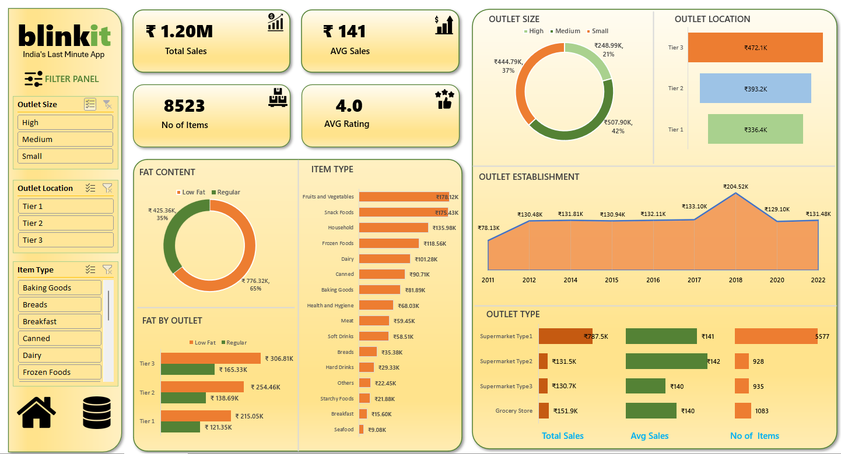
Dashboard
- Mithun Adhe (Data Analyst)

